Slide 1
Introduction
Welcome to the Tic-Tac-Toe Game Presentation!
Developed by Abdul Ahad

Slide 2
Game Overview
Tic-Tac-Toe is a classic two-player game.
Players take turns marking cells on a 3x3 grid.
The objective is to get three of your marks in a row, column, or diagonal.

Slide 3
Game Rules
Players will take turns.
Player 1 starts the game and sets "X", while Player 2 sets "O".
The board is marked with cell numbers (1-9).
Enter the cell number to place your mark.
To win, set 3 of your marks horizontally, vertically, or diagonally.

Slide 4
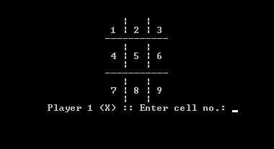
Example Board

Slide 5
Gameplay Mechanics
Each player takes turns entering a cell number to place their mark.
The game checks for winning combinations after each move.
If all cells are filled and no winner is found, the game ends in a draw.

Slide 6

OUTPUT Intro

Slide 7
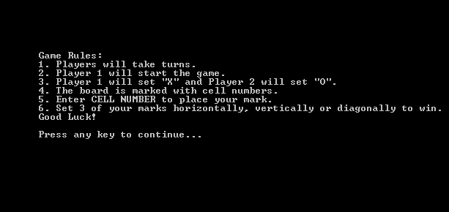
OUTPUT Rules

Slide 8
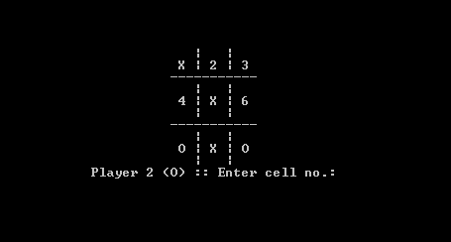
GAmePlay

Slide 9
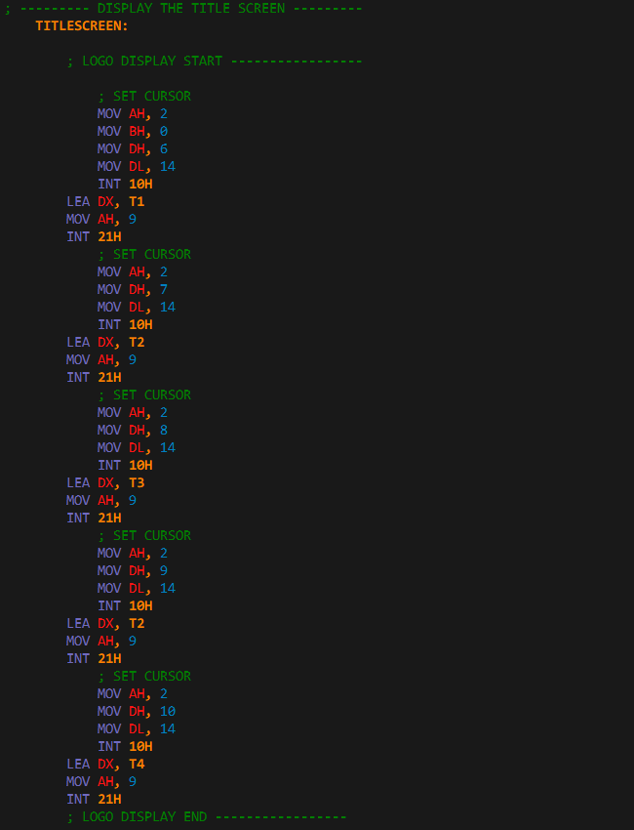
Intro Code
Print’s the Output Intro on the console screen

Slide 10
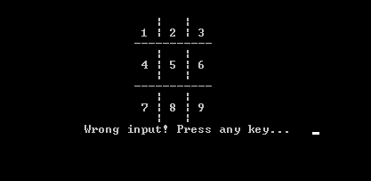
Invalid input Check

Slide 11
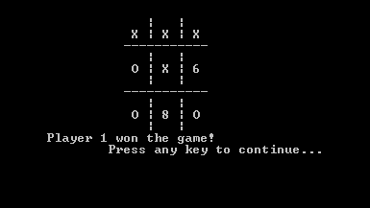
Player Win

Slide 12

Replay option

Slide 13
THANK YOU
Abdul Ahad
22-CS-071

